Slide 1
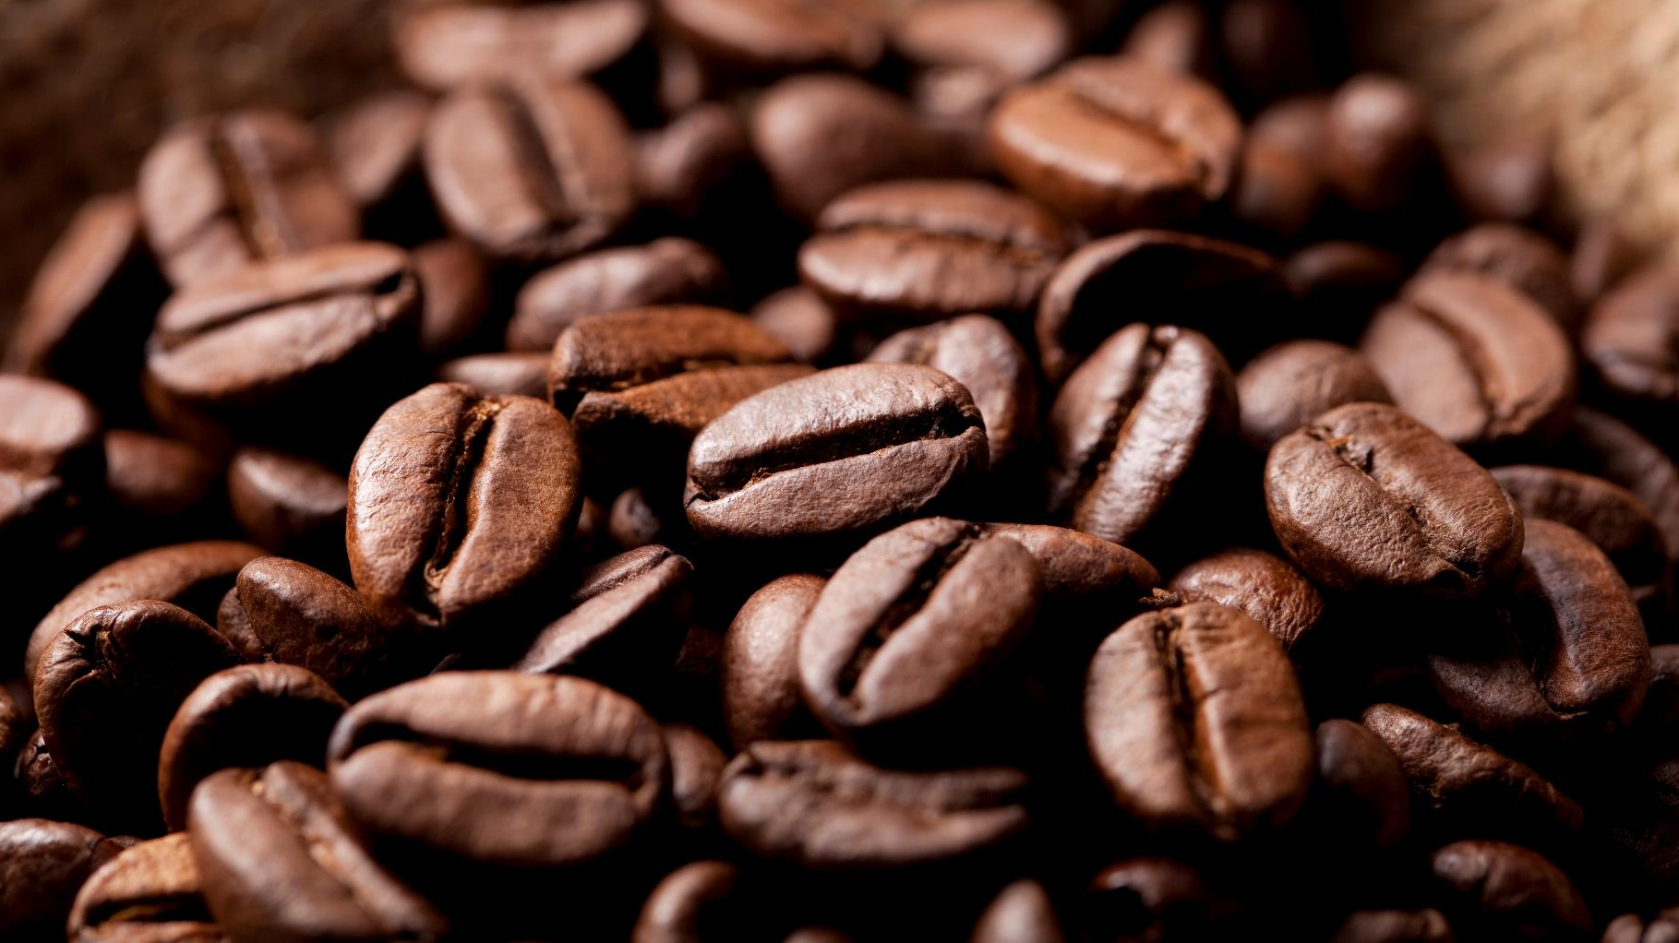
Walmart Coffee Listings
Lachandra Ash
November 17, 2022

Slide 2
Approach
Coffee Consumer
Ratings | Reviews |Price
Increase Revenue

Slide 3
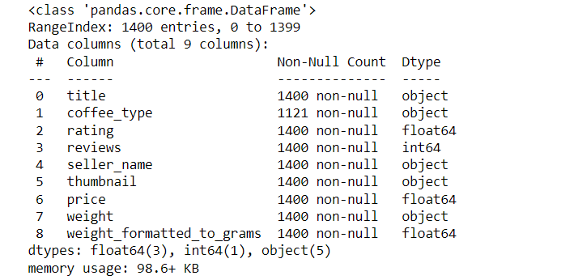
Walmart Coffee Listings Dataset

Slide 4

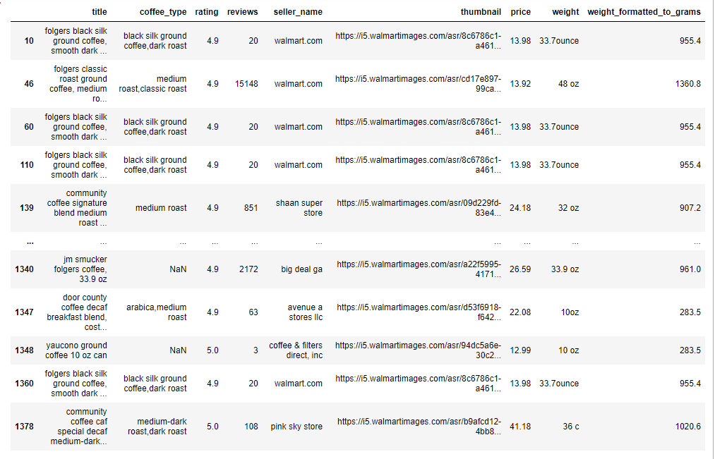
Best Coffees with highest ratings

Slide 5

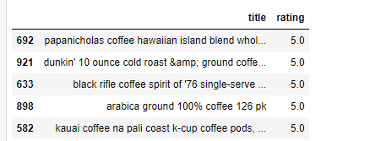
Coffees with the highest ratings

Slide 6

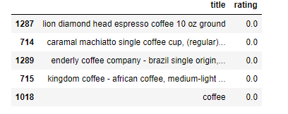
Coffee with lowest ratings

Slide 7
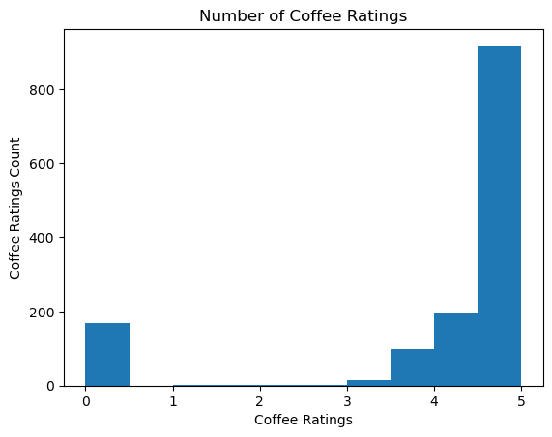
Coffee ratings and coffee ratings count
The coffee ratings between 4.5-5 had the highest number of coffee ratings.
Coffee ratings between 3-3.5 has the lowest number of coffee ratings.

Slide 8
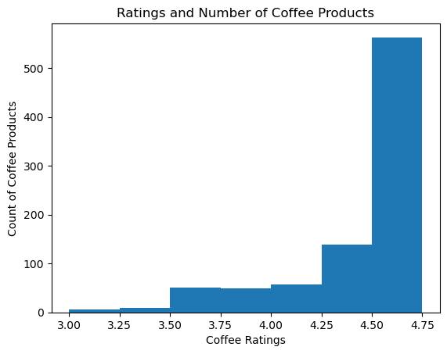
Coffee ratings and count of coffee products
The coffee ratings between 4,50-4.75 had the highest number of coffee products.
The coffee ratings between 3-3.50 had the least number of coffee products.

Slide 9
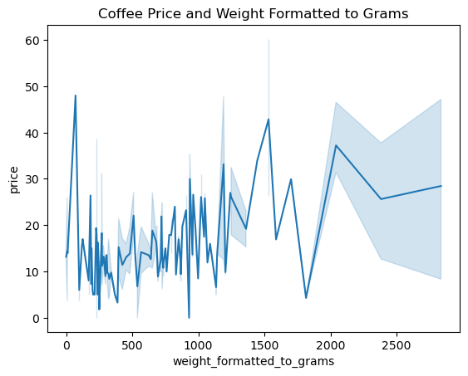
Coffee Weight formatted to grams vs price
The weight formatted to grams coffees with the highest numbers of coffee product prices are between 0-100.
The second weight formatted to grams coffees with the second highest number of coffee product prices are approximately 1,500.
The weight formatted to grams coffees with the lowest number of coffee product prices is approximately below 1,000.

Slide 10
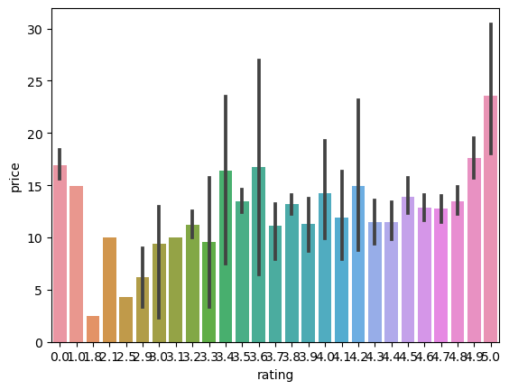
Coffee rating and Price
The coffee rating with the highest number of prices is 95.0.
The coffee rating with the least number of coffee product prices is 1.82.

Slide 11
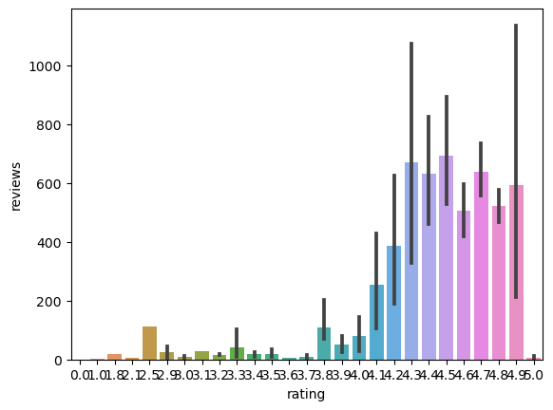
Coffee ratings and reviews
The coffees ratings with the highest number of reviews are between 24-95.
The coffee ratings with the lowest number of reviews are between 0 and 24.

Slide 12


Key to Success
Better Sales
ratings
Reviews
Greater
Consumer
Servies
Reduce Prices

Slide 13

conclusion
The Walmart coffee consumers need to buy the coffees with the highest ratings and affordable prices.
The consumers should view the weight of the coffee, price, ratings, and revies so they can view and order the greatest coffees with more weight for the lowest price and has high consumer reviews and ratings.
Walmart’s rating and reviews will motivate consumers to buy the best type of coffee, at a decent price, and the coffee is liked by many other consumers.
Walmart and their sponsors can decrease the prices of the coffees with the highest ratings and reviews, to increase consumer purchases and their revenue.

Slide 14


Thank You

